Slide 1
AZURE PLATFORM AS A SERVICE NETWORKING FUNDAMENTALS
Mika Haapsaari Finland Azure User Group 12/2019
12th December 2019

Slide 2

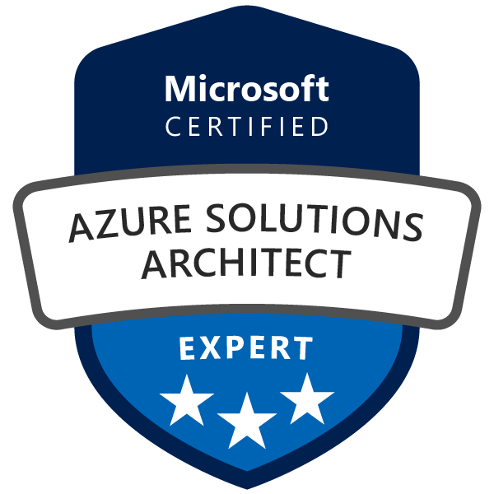

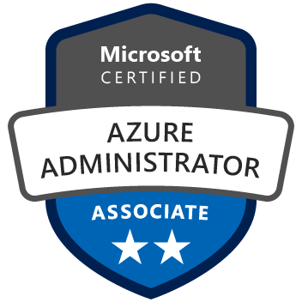
MIKA HAAPSAARI
ABOUT THE SPEAKER
Senior Cloud Architect, Azure Tech Lead and Team Lead @ Nordcloud
BBA in Business Information Systems
Working in different levels of IT for 10 years
Breaking Azure since 2012, full-day job since 2015

Slide 3
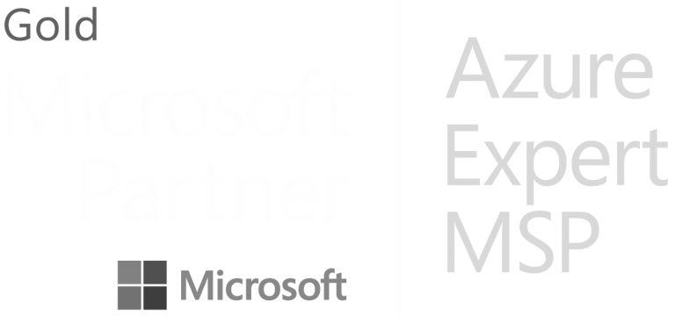
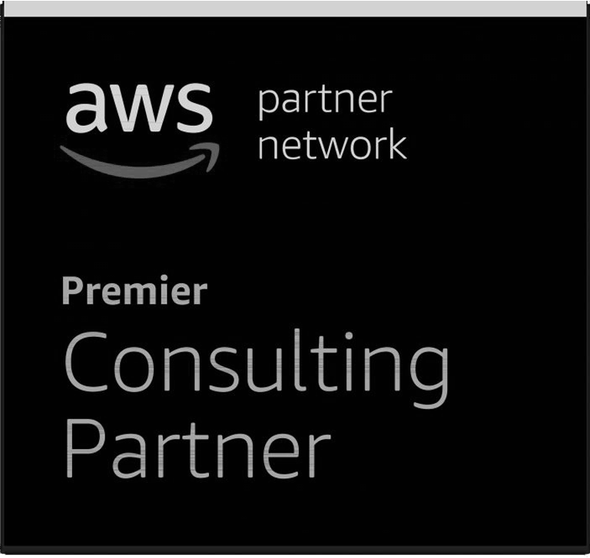
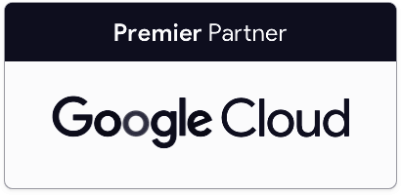
EUROPEAN LEADER IN PUBLIC CLOUD
ABOUT NORDCLOUD
420+ cloud experts
Presence in 8 countries
Born in the cloud in 2011
1000+ successful deployments
500% organic growth in past 3 years
Featured in The Financial Times FT 1000: Fastest Growing Companies in Europe 2019
3rd consecutive year in the Gartner’s Magic Quadrant for Public Cloud Infrastructure Professional and Managed Services

Slide 4
AZURE PLATFORM AS A SERVICE NETWORKING FUNDAMENTALS

Slide 5
“NETWORKING IN PAAS SOLUTIONS - WHY SHOULD I CARE?”

Slide 6
WHY SHOULD I CARE?
NETWORKING
Maybe you don’t - your customer might
Even if it’s encrypted
Even if there are no strict requirements, the peace of mind might be worth the trouble
Luckily there are options!
There are different scenarios where you might want to consider different private connectivity options - let’s look at those next

Slide 7
PAAS NETWORKING OPTIONS
NETWORKING
DIRECT CONNECTIVITY
MICROSOFT PEERING
SERVICE ENDPOINTS
PRIVATE LINK
The simple choice - direct connectivity between different service through the internet. Easy and nice, but guarantees against brute-force attacks outside the IP restrictions.
A flavor of Azure ExpressRoute that routes Microsoft public IPs in to your private WAN. A (more) secure way to access O365 and Azure PaaS services.
Direct connectivity from an Azure VNET, through the Azure backbone network to the PaaS service of your choice. Connectivity from on-premises/hybrid networks not possible.
A new option of connectivity in the product line, that provides private access from Azure VNETs, hybrid networks and on-premises networks with private IP addresses.

Slide 8
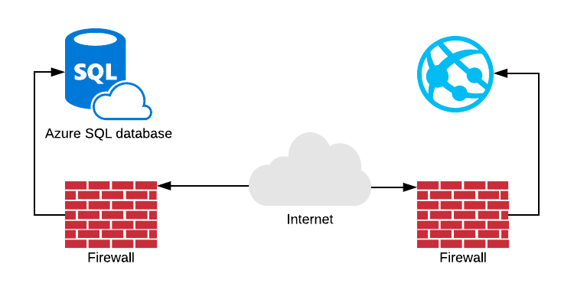
DIRECT CONNECTIVITY
PAAS NETWORKING OPTIONS

Slide 9
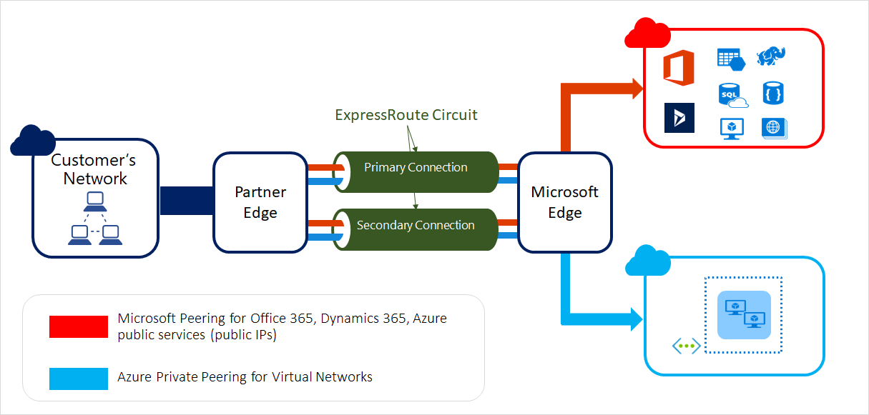
MICROSOFT PEERING
PAAS NETWORKING OPTIONS

Slide 10
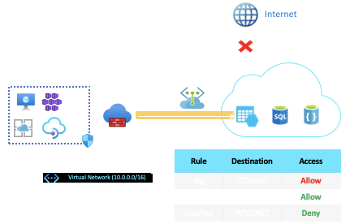
SERVICE ENDPOINTS
PAAS NETWORKING OPTIONS

Slide 11

PRIVATE LINK SERVICE
PAAS NETWORKING OPTIONS

Slide 12
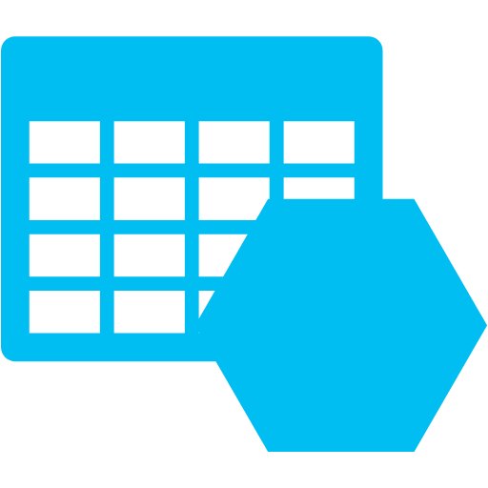
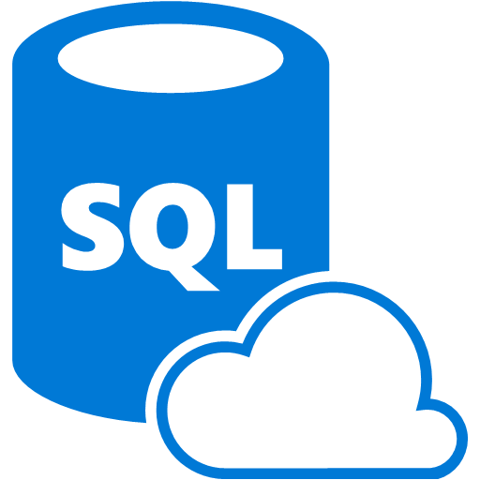
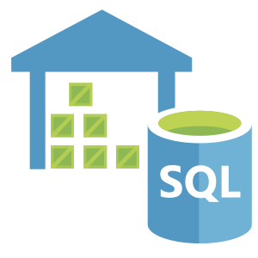






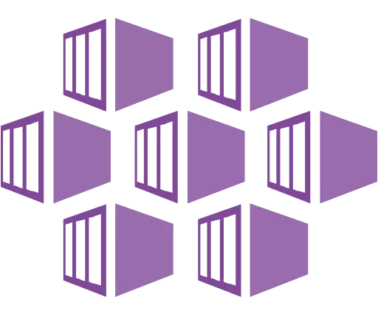
SUPPORTED SERVICES IN PRIVATE LINK
PRIVATE LINK SERVICE
CURRENTLY
ROADMAP
Notes:
INCLUDING DataLake Gen 2 storage

Slide 13
PRIVATE LINK SERVICE
PRIVATE LINK SERVICE
Services can be access from
Azure Virtual networks
Peered Virtual networks
VPN tunnels
Private ExpressRoute peering
Also has cross-tenant support!

Slide 14
RECAP

Slide 15
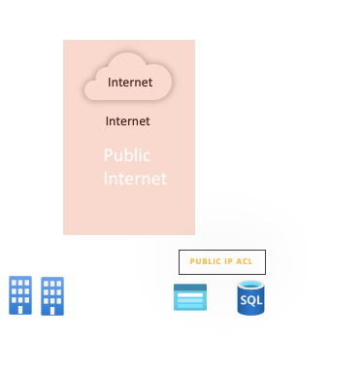
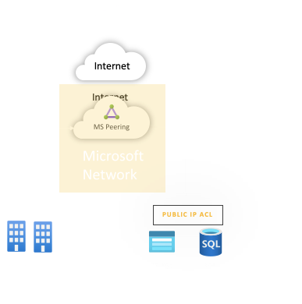
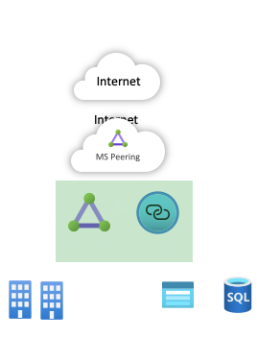
ON-PREMISES CONNECTIVITY OPTIONS
•Traffic traverses the Internet
•Secured using ACLs on Public Ips
•Corporate firewall open to Azure Public IPs
•Traffic stays within Microsoft and partner network
•MS Peering draws Microsoft Public IP traffic
•Corporate Firewall open to Azure Public IPs
•Traffic is fully private traversing the Microsoft network
•No exposure of public IPs on either side
•Corporate Firewall open only to private

Slide 16

DEMO TIME!

Slide 17
THANK YOU!
Holler at me:
Twitter: @mikahaapsaari
LinkedIn: @mikahaapsaari
Email: mika.haapsaari@nordcloud.com

